Slide 1
Zomato Restaurants Analysis
A demonstration by Arpit Shrotriya

Slide 2

Online Delivery Restaurants

Slide 3

Spreadsheet Project:
Zomato Restaurants Analysis

Slide 4

Unveiling Restaurant Insights
The project aims to harness the power of data analytics to provide valuable insights for restaurant owners and stakeholders. By analyzing restaurant data, the project seeks to address critical challenges in the industry, such as identifying new opportunities for growth, understanding customer preferences, and optimizing operational efficiency.

Slide 5
Restaurant owners grapple with several key challenges:
Understanding Customer Preferences: Meeting diverse customer needs and expectations, from food choices to dining experiences, requires a deep understanding of consumer preferences.
Pricing Strategies: Striking the right balance between profitability and affordability while remaining competitive in the market is crucial for successful pricing strategies.
Menu Optimization: Designing menus that appeal to customers and maximize profitability involves considering ingredient costs, dish popularity, and seasonal trends.
Quotes for illustration purposes only

Slide 6

Scenario Highlighting the Need for Data-Driven Insights
Scenario 1: A restaurant introduces a new menu item based on intuition and customer feedback gathered informally. However, sales of the new item are lower than expected, leading to wasted resources and missed revenue opportunities.
Scenario 2: A restaurant experiences a sudden drop in foot traffic during certain days of the week. Without data to analyze customer traffic patterns and identify potential reasons for the decline, the restaurant struggles to implement targeted solutions to attract more diners.

Slide 7
Importance of Each Task in Addressing the Identified Problem:
Data cleaning ensures the accuracy of analyses, providing reliable insights for decision-making.
Restaurant distribution analysis identifies growth opportunities and areas for market expansion.
Quality assessment based on ratings helps prioritize improvements to enhance customer satisfaction.
Financial expenditure evaluation aids in cost management and pricing strategy development.
Analyzing the influence of service offerings assists in optimizing operations and improving customer experiences.

Slide 8

Data Cleaning
In this phase of the project, the focus was on preparing the data for analysis by cleaning it and addressing any inconsistencies or missing values. The following steps were taken to clean the data using appropriate Excel formulas
Handling Null or Mishandled Values
Filling Country Names Using VLOOKUP
Ensuring Consistency and Accuracy

Slide 9


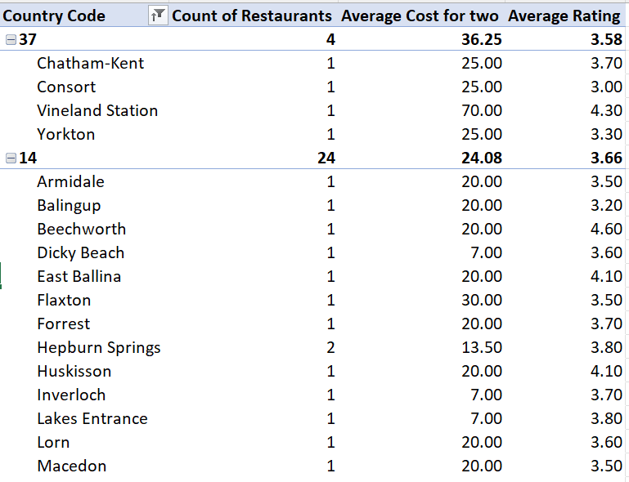
Current Quality of Restaurants
A comprehensive analysis of the current quality of restaurants in the suggested countries based on ratings and the count of votes.
By examining these key metrics, stakeholders gain valuable insights into customer satisfaction levels and the overall performance of restaurants within the target markets.

Slide 10
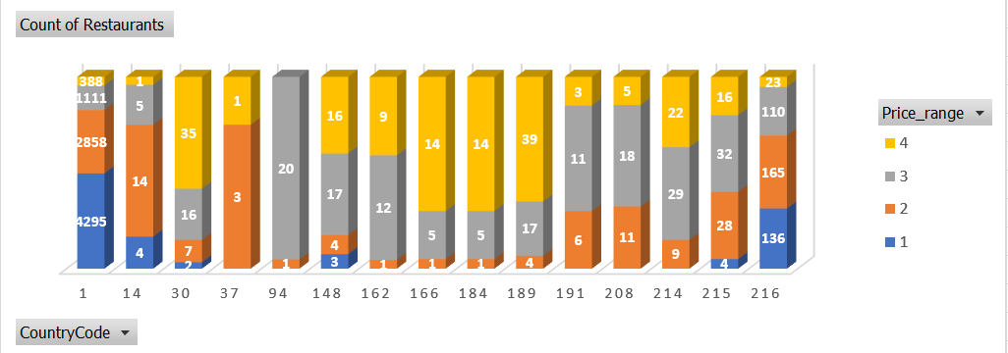
1. Restaurant Distribution by Country
This slide presents a table illustrating the distribution of restaurants opened in each country, providing valuable insights into the geographic spread of restaurant establishments.

Slide 11
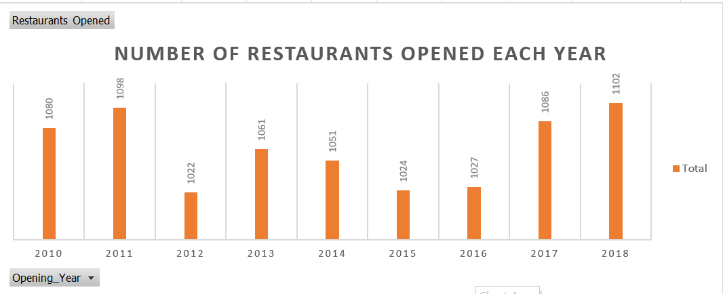
Restaurants Opened Each Year

Slide 12
Countries with Lesser Competition
Recommendations for countries where opening new restaurants could be strategically advantageous based on an analysis of the count of restaurants and the average cost for two people.
Canada (Country Code 37):
Reasoning: With only four cities having one restaurant each, Canada presents potential areas with relatively low competition, indicating opportunities for market entry and growth.
Insights: The limited number of restaurants coupled with a diverse culinary landscape and moderate average cost for dining out make Canada an attractive market for new restaurant ventures.
Australia (Country Code 14):
Reasoning: Australia exhibits a favorable landscape for new restaurant openings, with each city featuring only one restaurant and offering nominal prices for dining out.
Insights: The combination of low competition and affordable dining options suggests a conducive environment for establishing new culinary ventures in Australia.

Slide 13
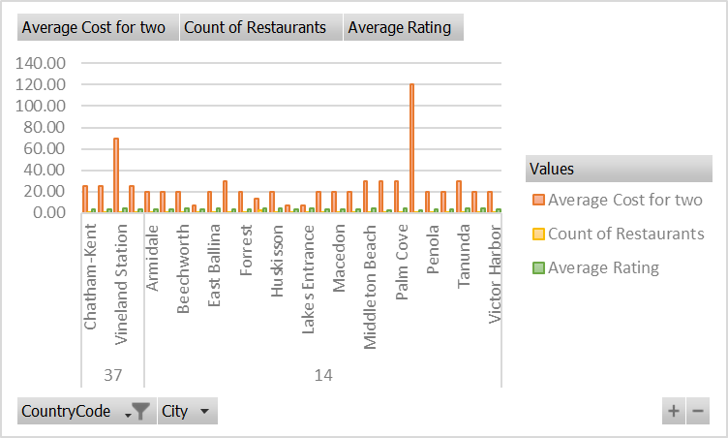
Expenditure on Food in Suggested Countries
A concise summary of the average cost for two people dining out in the suggested countries. By presenting this information, stakeholders gain valuable insights into the financial expenditure associated with operating.

Slide 14

Influence of Online Delivery and Table Booking
By examining the correlation between service offerings and customer feedback, stakeholders gain valuable insights into the importance of these services in enhancing overall customer satisfaction and loyalty.

Slide 15

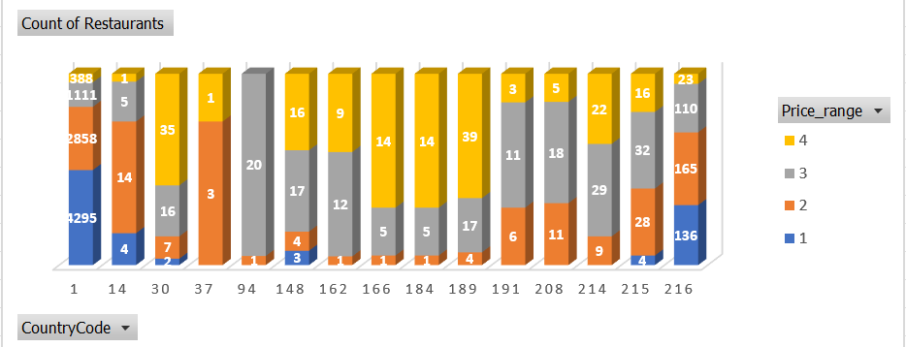
Distribution of Different Price Ranges

Slide 16

Conclusion
Key findings derived from the analysis conducted on various aspects of the restaurant industry, accompanied by actionable recommendations for stakeholders.
Customer Preferences and Satisfaction
Competitive Landscape and Market Opportunities
Financial Considerations and Cost Management

Slide 17

Thank you
We look forward to the opportunity for expanding restaurants to new countries to collaborate with you and contribute to the culinary-success in the future.

